Slide 1
Microsoft Cognitive Services
Christina E. Leo
christina.leo@microsoft.com
1 May 2019

Slide 2










Why Microsoft Cognitive Services?
Easy
Flexible
Tested
Roll your own with REST APIs
Simple to add: just a few lines of code required
Integrate into the language and platform of your choice
Breadth of offerings helps you find the right API for your app
Bring your own data for your custom experience
Built by experts in their field from Microsoft Research, Bing, and Azure Machine Learning
Quality documentation, sample code, and community support
GET A KEY
BUILD
Notes:
Why choose these APIs? They work, and it’s easy.
Easy: common implementation, everything at one website
Flexible: broad range of options, bring your dev tools
Tested: developed by experts Microsoft’s Research organization, Bing, and Azure machine learning, we use them in our own products as Bing, Skype, SQL Server, PowerBI

Slide 3







Microsoft Cognitive Services
Give your apps a human side
Vision
Speech
Language
Knowledge
Search
Labs
Computer Vision
Content Moderator
Face
Video Indexer*
Speech to Text*
Text to Speech*
Speech Translation*
Speaker Recognition*
Bing Spell Check
Translator Text
Text Analytics
Content Moderator
Linguistic Analysis*
Web Language Model*
QnA Maker
Bing News Search
Bing Video Search
Bing Web Search
Bing Autosuggest
Bing Entity Search
Bing Image Search
Bing Visual Search
Gesture
Personality Chat
Event Tracking
Academic Knowledge
Local Insights
Knowledge Exploration
Entity Linking
URL Preview
Answer Search
Anomaly Finder
Conversation Learner
CUSTOMIZATION
Custom Vision Service
Custom Speech Service*
Language Understanding (LUIS)
Custom Decision Service*
Bing Custom Search
*Preview

Slide 4
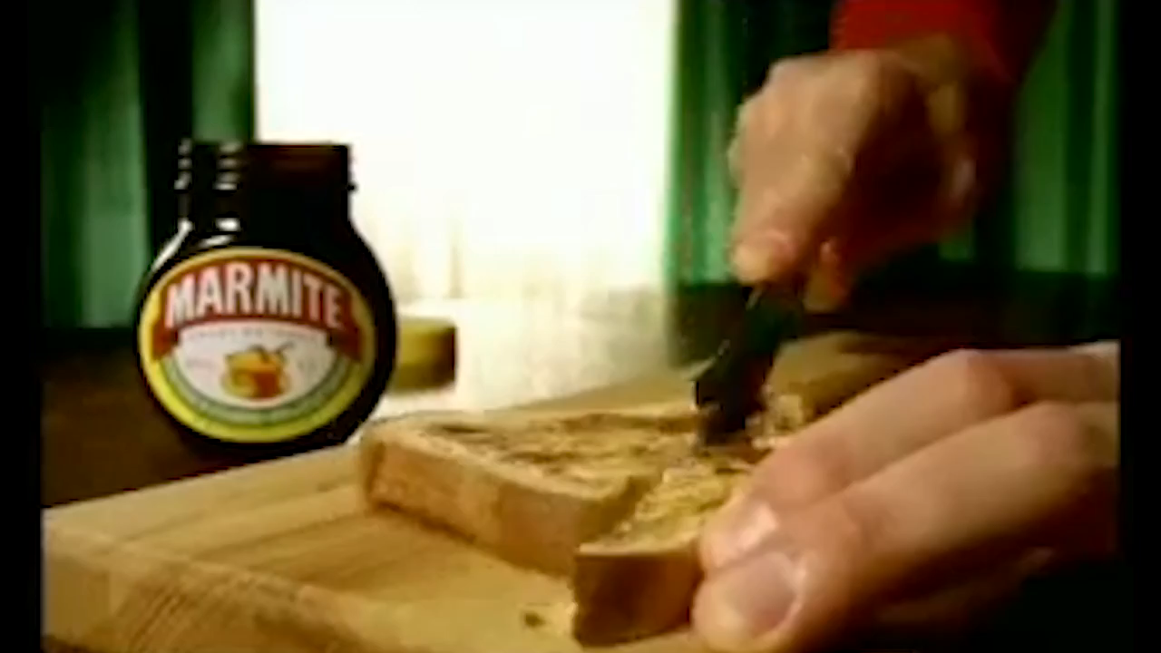

Slide 5
Let’s look at some demos.

Slide 6





Sentiment over time in a business.
Text divisible over time
Identifiable ‘characters’
Ability to take action
Email and Chat Transcripts
Call Centre Transcripts
News and Social Media
New transcripts
New possibilities for action
New improved interactions
Education and learning
Bot interactions
Notes:
How would you apply something like this to your business?
Do you have access to any of these thing?
(Build 1 to 5)
What you need (Build)
- Text over time
- Who is saying what
- Actionable: need to be able to do something because of what you learn.
(Build): and Bots bring a whole new set of conversational content into your business.
And this data set could be used with machine learning capabilities to help adjust a bot a bot to play out a narrative suitable to your outcomes based on an understanding of how the conversation has gone to date.

Slide 7
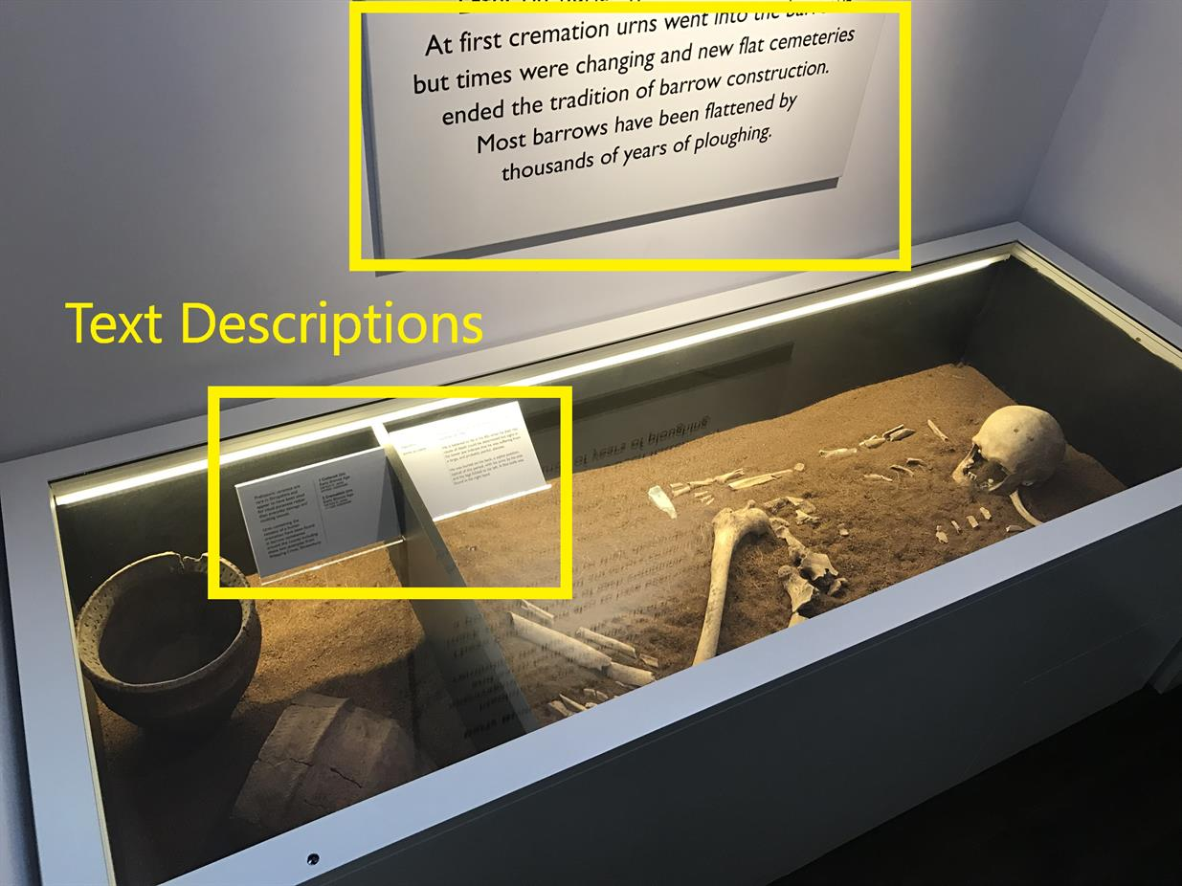
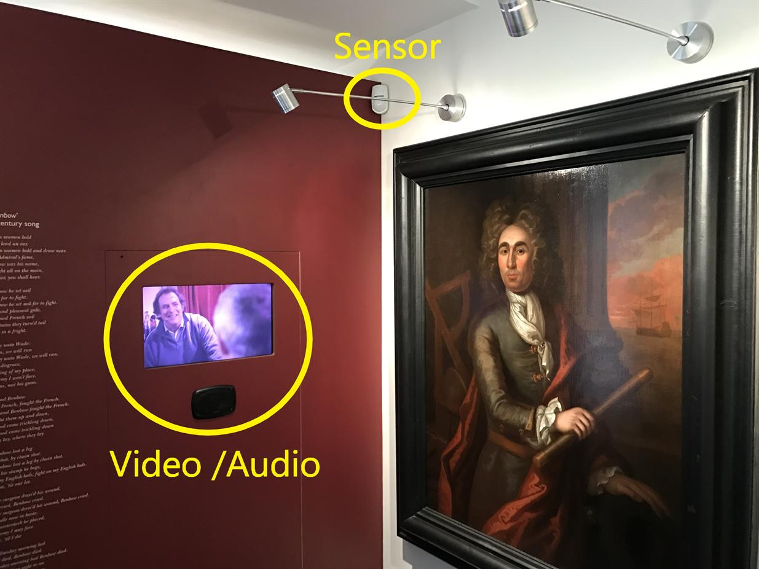




Black Radley and Shrewsbury Museum & Art Gallery…
Using Cognitive Services to make museum exhibits more compelling and track user behaviour
Track
Analyse
Understand
Improve
Notes:
Microsoft teamed up with Black Radley and the Shrewsbury Museum & Art Gallery to create a solution that would react to museum patrons as they interact with exhibits based upon their approximate age, gender, and emotional state. Additionally, the solution would provide detailed insight on how patrons traverse the museum, which exhibits they linger at, and for how long.
The goal was to address problems that museums face around making exhibits more compelling for patrons and better understand how patrons use the museums.
The existing practice within the museum was augmented with AI.
Improve exhibits by using cognitive intelligence to give a tailored experience based upon demographic information.
- Track and report on how patrons interact with exhibits and the museum as a whole to allow the museum to report to funding bodies and better understand their customers.
FOUR BUILDS with this statement
More on this later

Slide 8
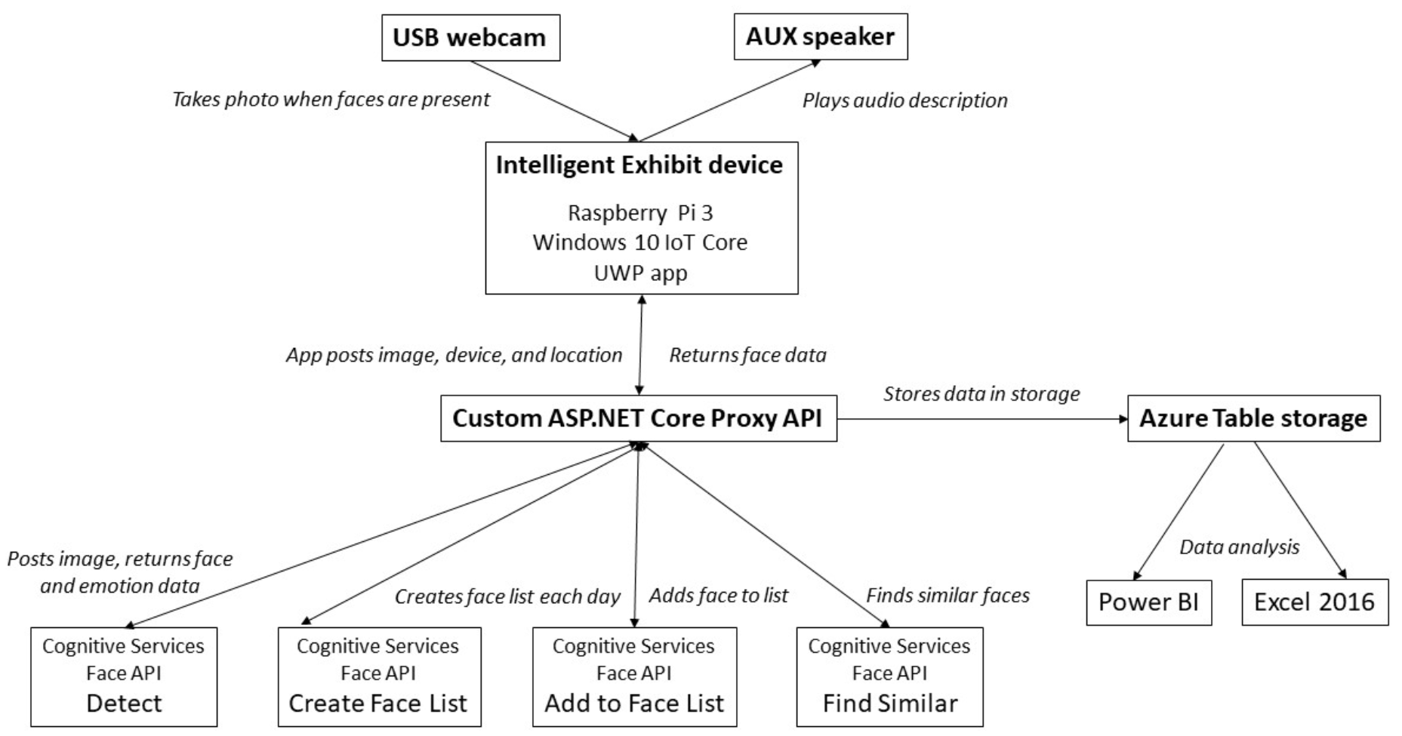
Build
Cognitive Services
Power BI
Notes:
Microsoft teamed up with Black Radley and the Shrewsbury Museum & Art Gallery to create a solution that would react to museum patrons as they interact with exhibits based upon their approximate age, gender, and emotional state. Additionally, the solution would provide detailed insight on how patrons traverse the museum, which exhibits they linger at, and for how long.
The goal was to address problems that museums face around making exhibits more compelling for patrons and better understand how patrons use the museums.

Slide 9
Using the Computer Vison API with Python
Custom Speech Model
Find the code here:
https://github.com/christinaleo-msft/SQLSoton.git

